Slide 1
Pivot Tables in Excel
© McGraw Hill LLC. All rights reserved. No reproduction or distribution without the prior written consent of McGraw Hill LLC.

Slide 2
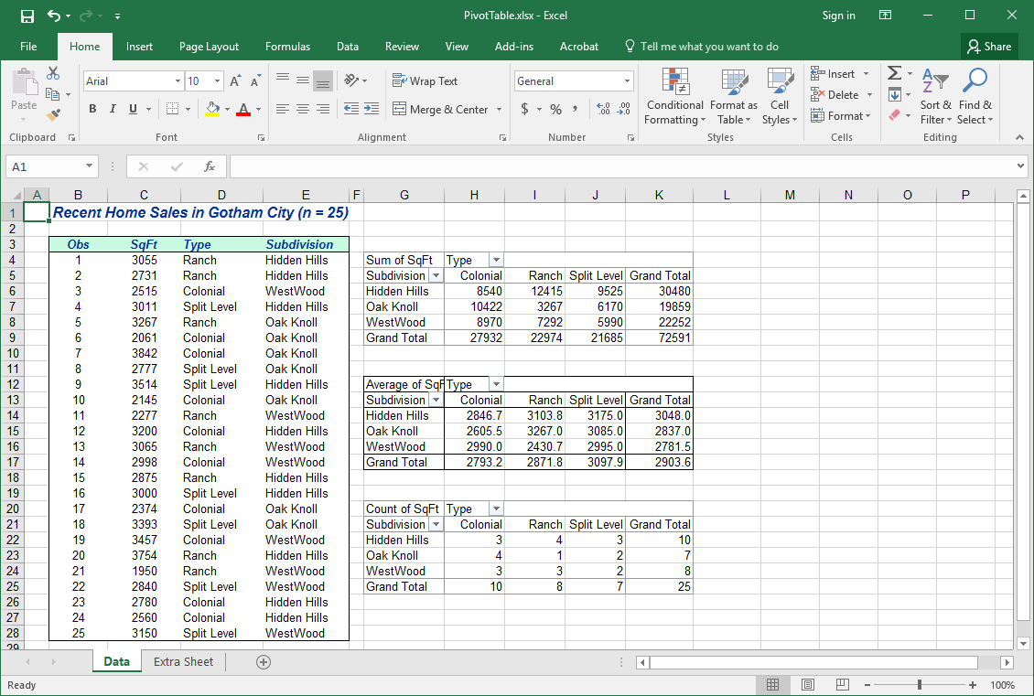
What Is a Pivot Table?
It is a cross-tabulation of data.
Here are three pivot tables. Let’s see how they were constructed.

Slide 3
Data Entry
Step 1. Enter the data columns in Excel.
Recent Home Sales in Gotham City (n = 25)

Slide 4
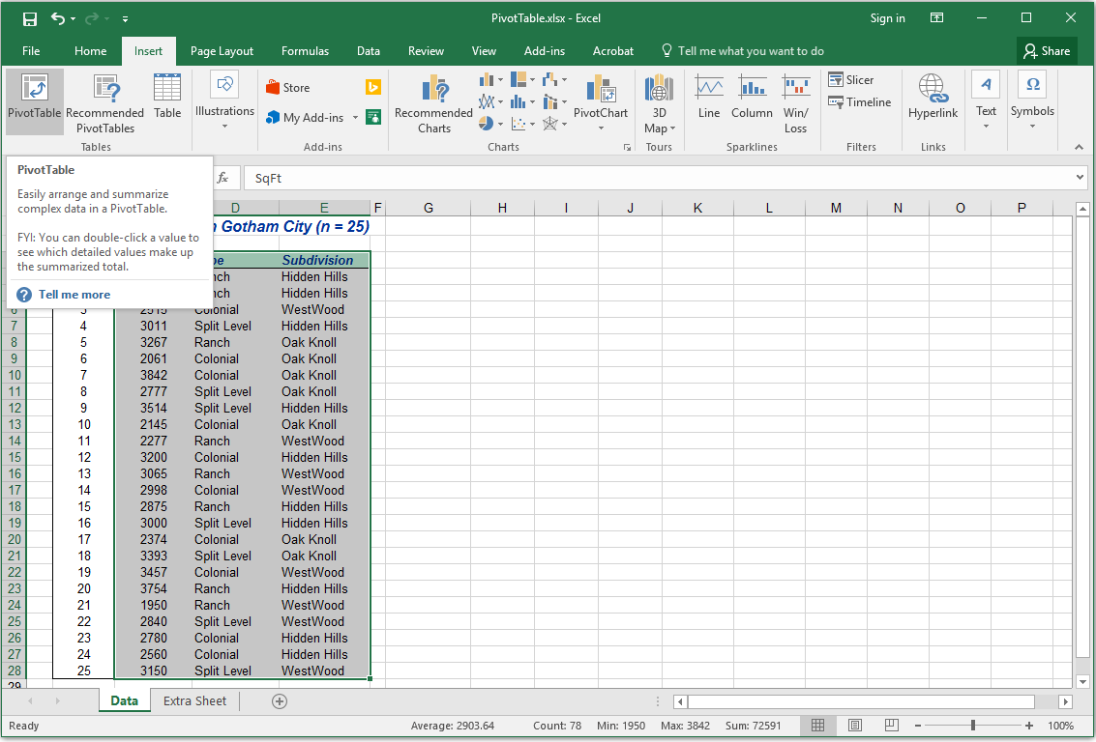
Insert Pivot Table
Step 2. Highlight the data, click the Insert ribbon, and click Pivot Table.

Slide 5
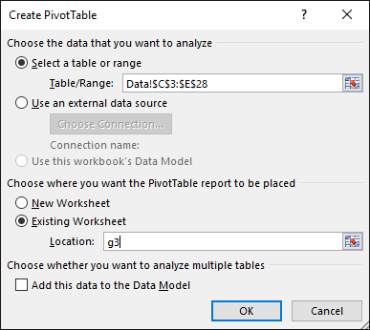
Check Data Range
Step 3. Verify the data range (include the column headings).

Slide 6
Pivot Table Location
Step 4. Specify upper left corner of pivot table location (or choose a new worksheet).

Slide 7
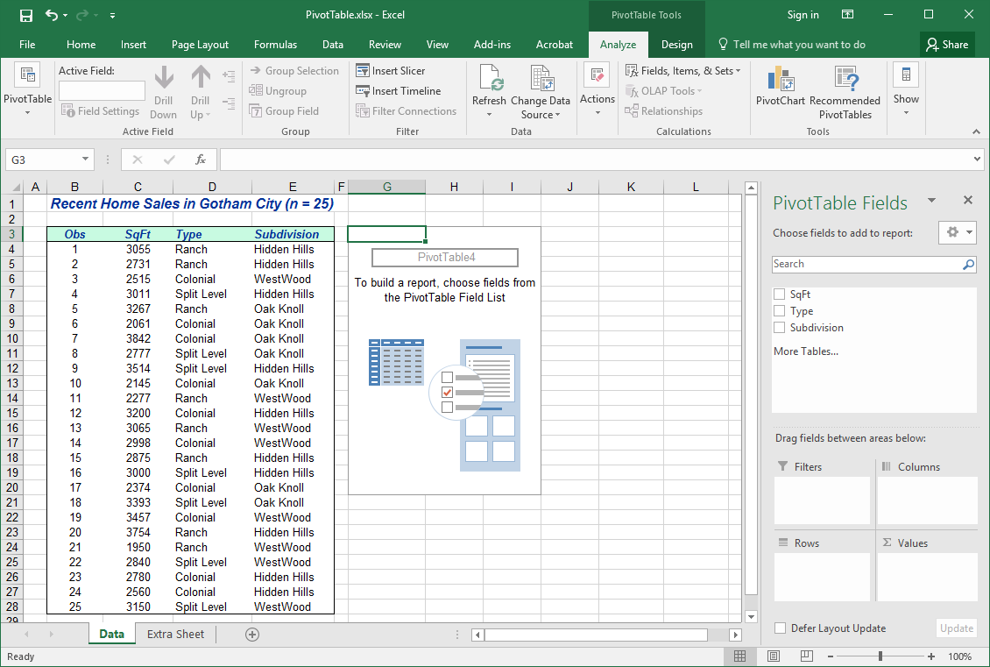
Blank Table
Step 5. You now have a blank report. You will drag variables from the Pivot Table Fields.

Slide 8
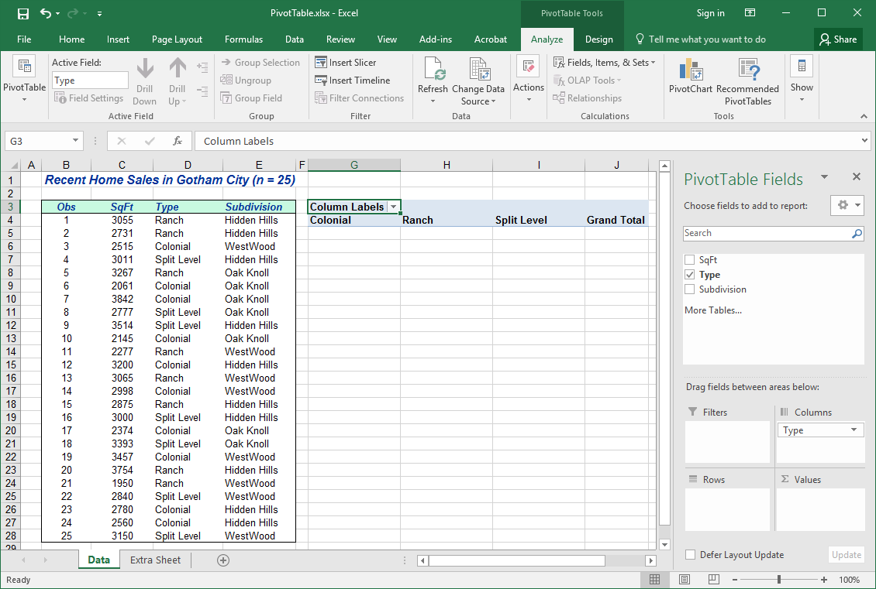
Drag Column Field
Step 6. Drag Type from the Pivot Table Field List to Columns in the Drop Fields space at the top of the table.
Four home types now appear as column headings.

Slide 9
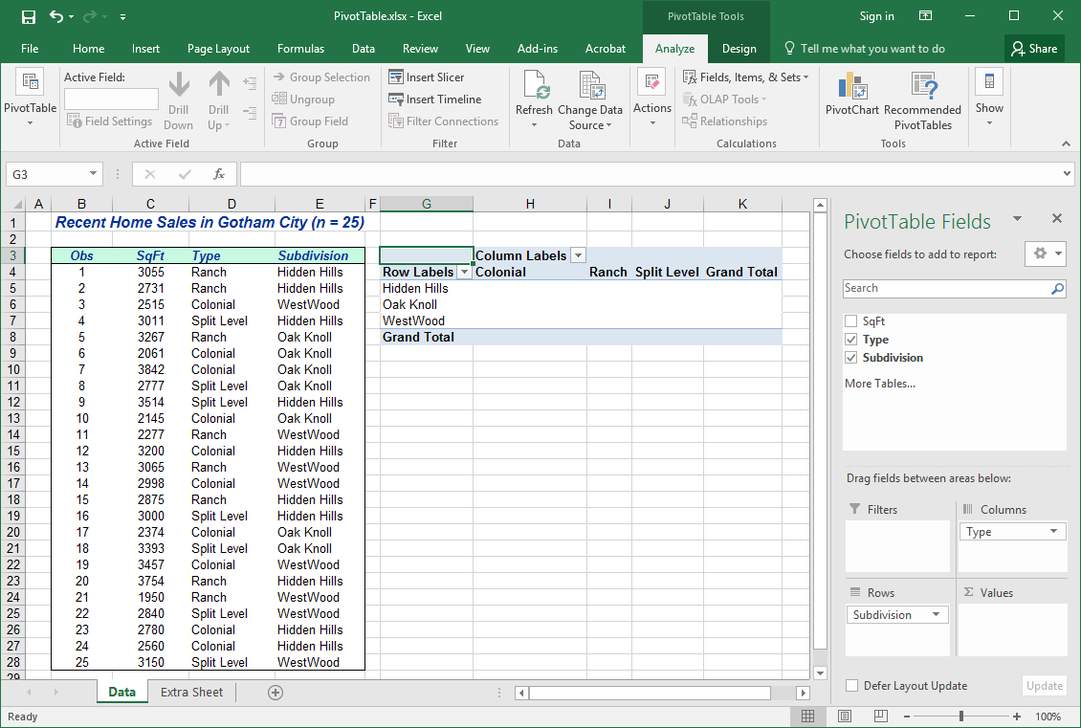
Drag Row Field
Step 7. Drag Subdivision from the Pivot Table Field List to Rows in the Drop Fields space at the left side of the table.
Three subdivision names now appear as row names.

Slide 10
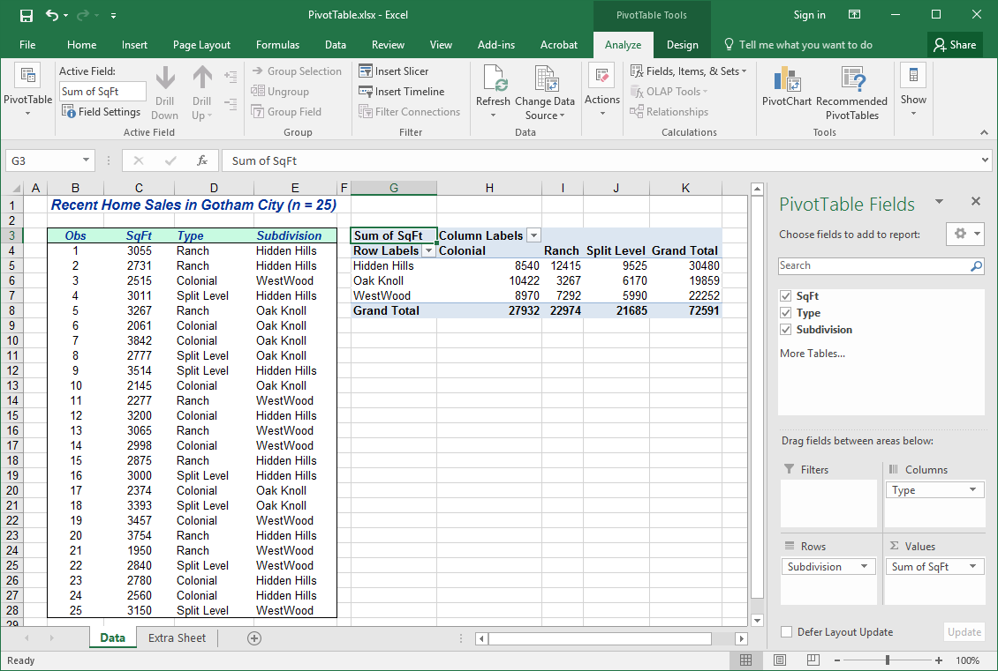
Drag Data Field
Step 8. Drag SqFt from the Pivot Table Field List to the main body of the table. You are done.
By default, the Pivot Table shows sums of all home sizes in each cell.

Slide 11
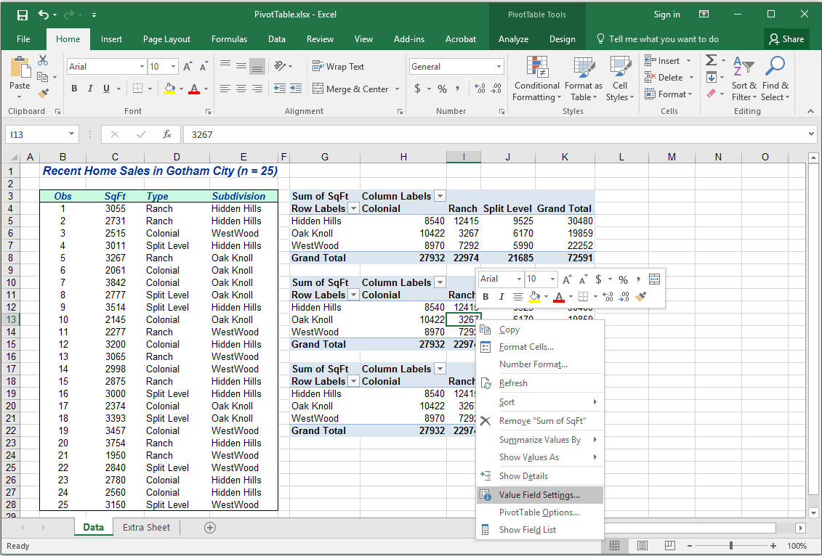
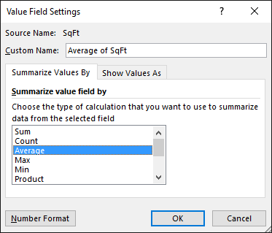
Choose Value Field
Step 9. Right-click inside a report cell and choose Value Field Settings to display the statistic you want (e.g., Average).
We copied the table and pasted it so we could show three different value fields (next slide).

Slide 12
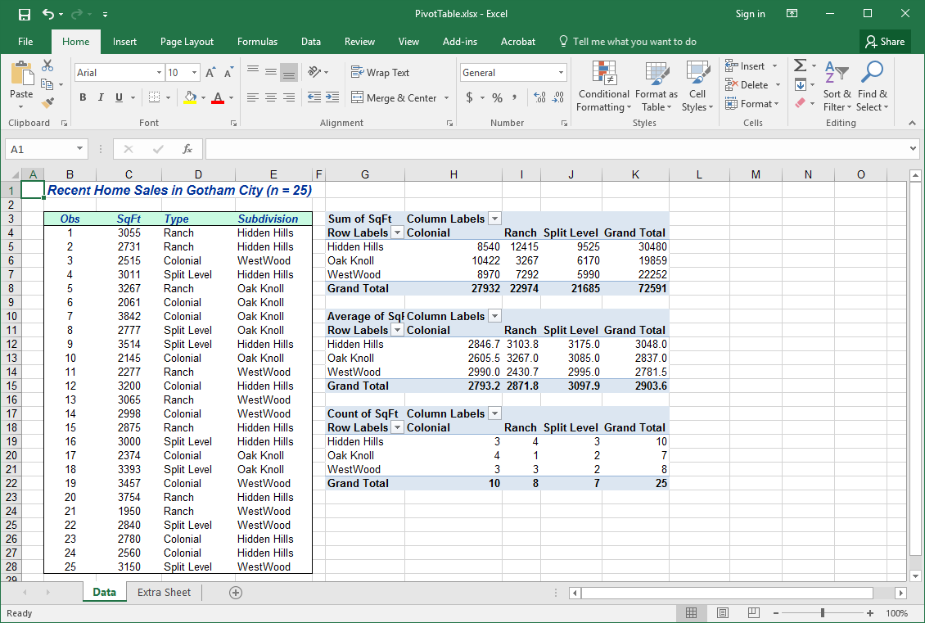
Customize It
Step 10. You can format the cells (decimals, font, centering, etc.).
First pivot table shows the sum of home sizes in the category.
Second pivot table shows the average home size in each category.
Third pivot table shows the count of homes in the category.

Slide 13
Other Value Fields
Step 11. Click inside the table. Scroll down the list of Value Fields to display.
Not only can you display the sum, count, average, max, min, but also you can show standard deviations and variances. Very nice for financial analysis!

Slide 14
Bottom Line
Pivot tables are a powerful analytical tool for decision-making.
You can analyze data in various ways (sum, average, count, min, max).
It would be difficult to create such tables manually.
Pivot table content is updated if you change the data.
Useful focus for team discussions.

